Slide 1

WEEK 3 PROGRESS REPORT
AIRFRAME TEAM

Slide 2
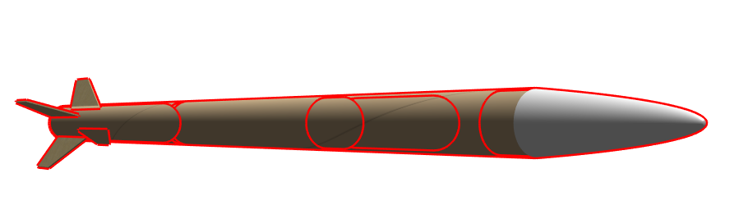
Objectives
Tasks completed
#29 Prefabricated aluminum tube search.
#30 Designing on how to mount the solid rocket motor onto rocket.
#35 Calculating the strength of the fastening bolts.
#41 Designing of a faster assembly mechanism.
#22 Designing of a cone shaped deflector.
Remaining Tasks:
Fabrication

Slide 3
Prefabricated aluminium tube search
Material in search- aluminium tube of grade AA 6061 of internal diameter of 75mm and thickness of 2mm.
Company | Location | Material present
Hydro aluminium company | Silver business park | AA 6063 tubes and shafts
Aquva agencies | Industrial Area | Currently AA1050 sheet
Kens metal company | Industrial Area | AA7075 Sheet
Suggested area | Kariobangi | Both material AA6061 and fabrication

Slide 4
METHODOLOGY
STEP 1
Simulation using OpenRocket
STEP 2
Drawing using SolidWorks
DESIGN AND SIMULATION
STEP 3
Simulation using Ansys and SolidWorks

Slide 5
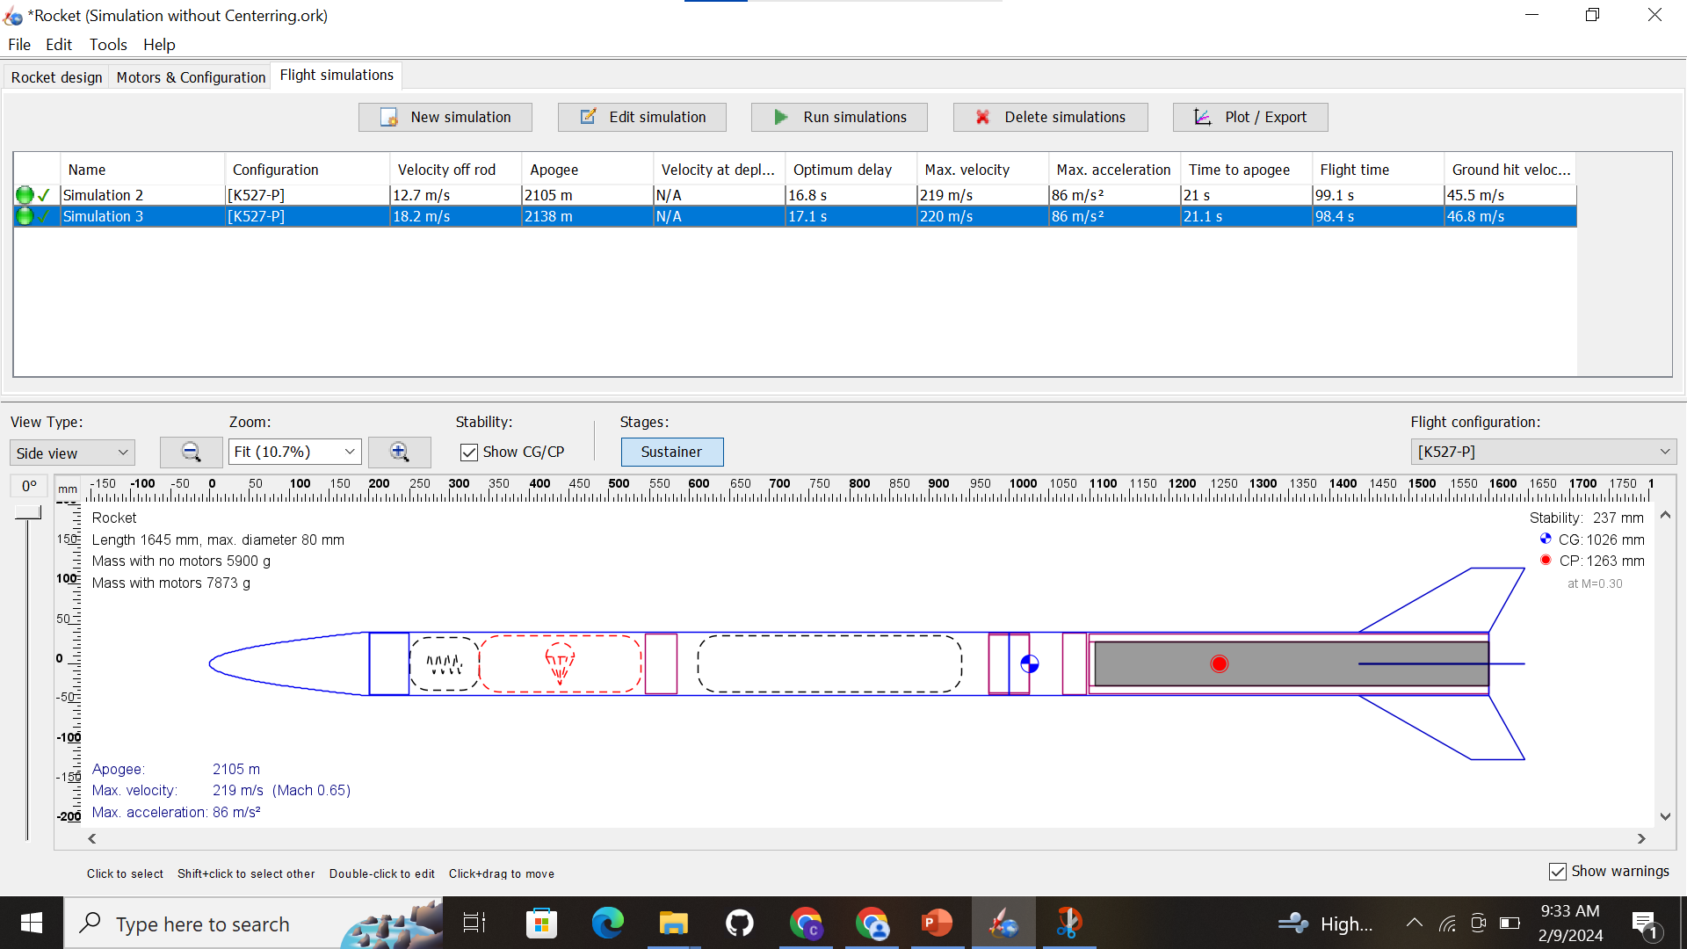
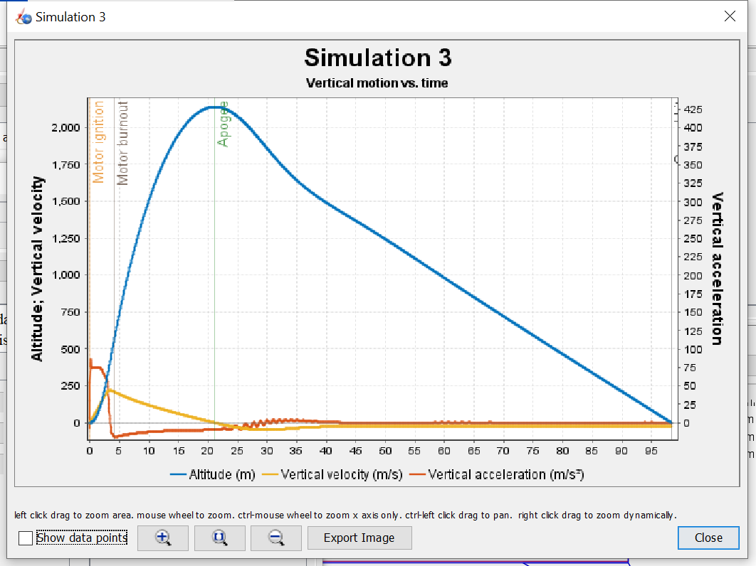
OPENROCKET SIMULATION
Obtaining the motor casing diameter, the desired design was simulated.

Slide 6
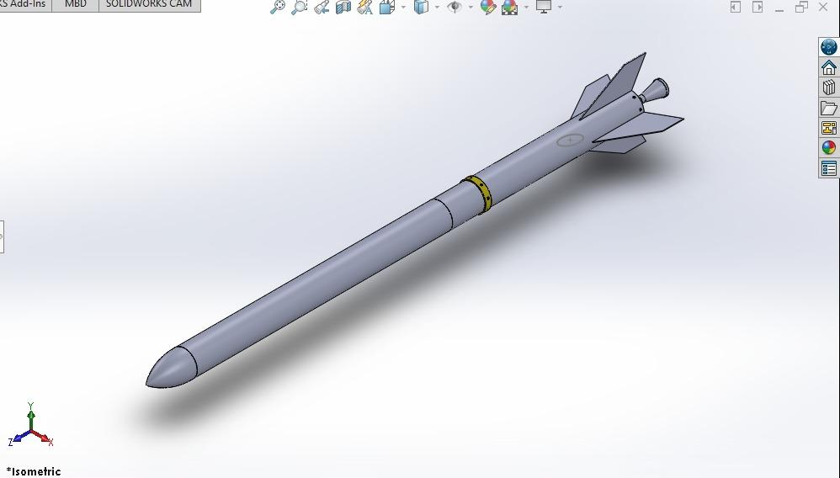
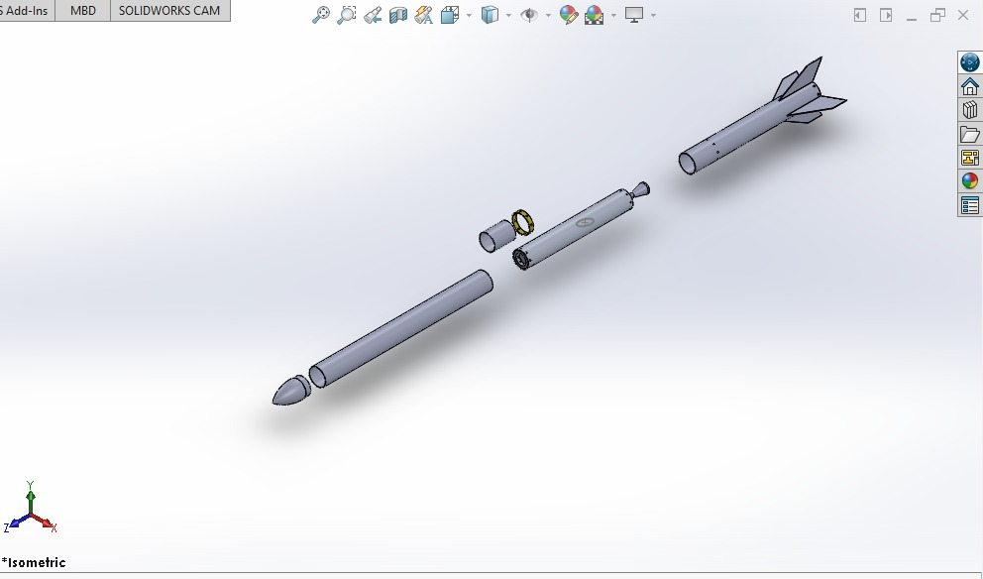
SOLIDWORKS DRAWINGS
Parts and drawings

Slide 7
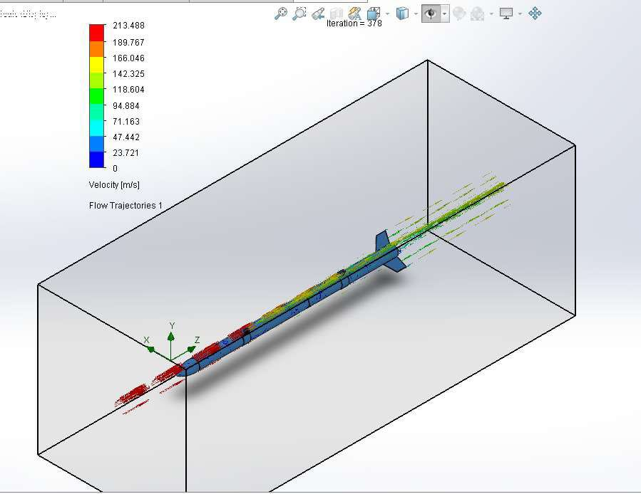
Solidworks simulation
Aerodynamics Simulation of the rocket

Slide 8
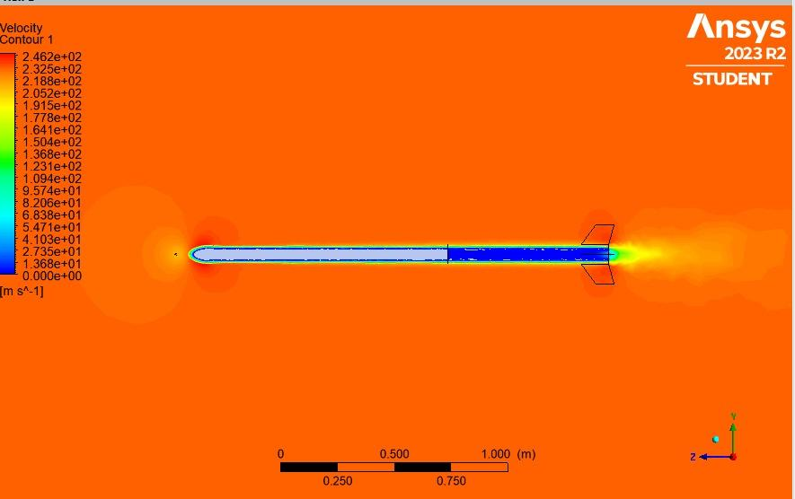
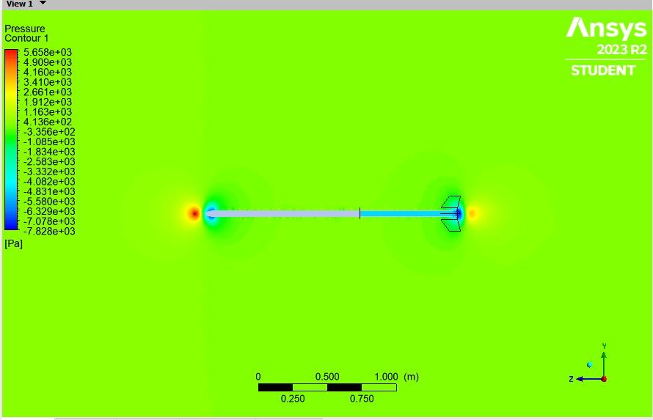
ANSYS SIMULATIONS
Airframe aerodynamics investigations: velocity, and pressure.

Slide 9
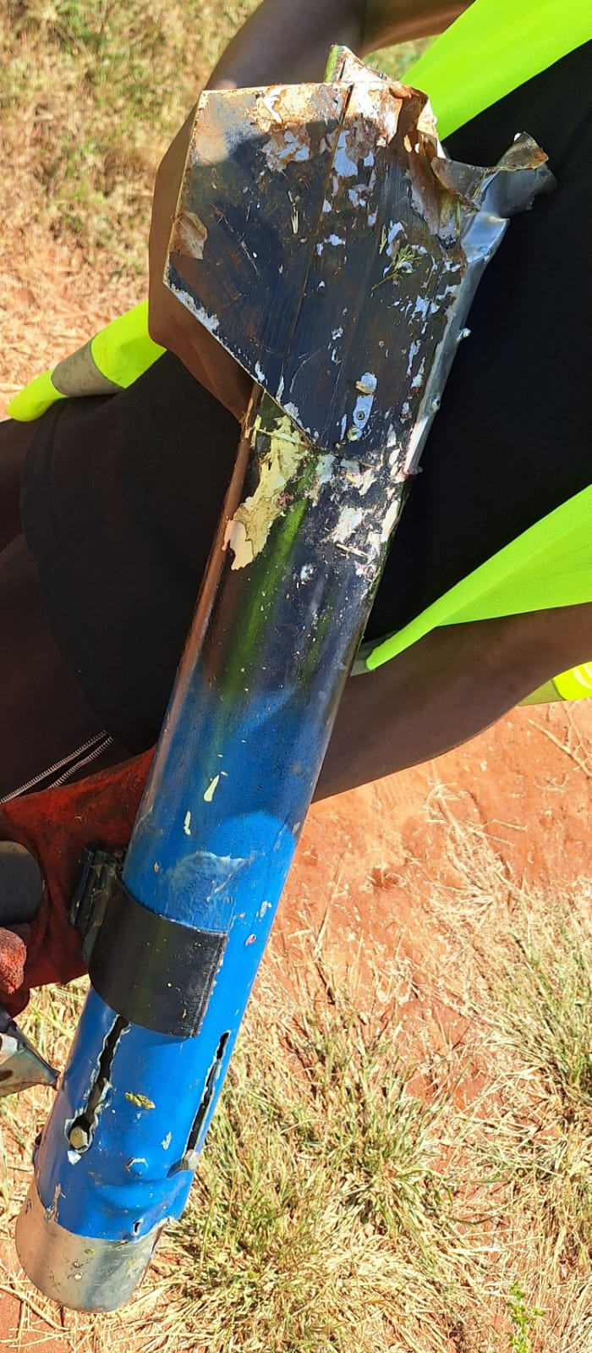
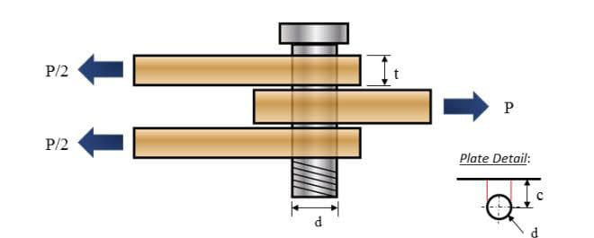
Mounting the solid rocket motor onto rocket
N3 design Proposed design
4 bolts holding motor casing to the airframe.
4 bolts holding the motor casing to the nozzle and buckle head.
Ensure an airtight assembly and use of a single bolt cutting through the airframe,motor casing and the nozzle.

Slide 10
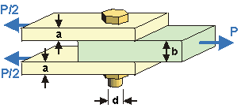
Calculating the strength of the fastening bolt
Double shear of the bolt.
Estimated total mass=10kg
Equations used:
F.chamber = P. max X Cross S.A
F.airframe(weight) = Mass X Acceleration
Shear stress at each bolt = Total Force /C.S.A
= 124.4 N/mm2, which is < 176 N/mm2

Slide 11
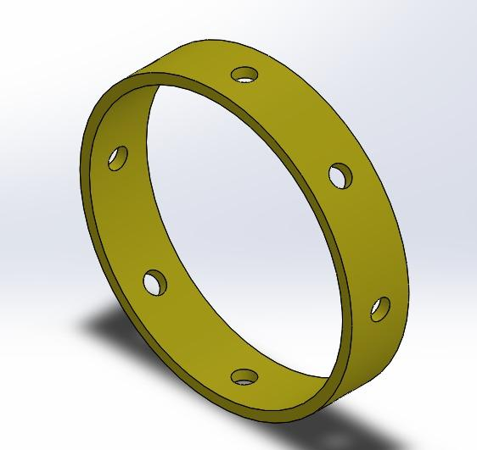
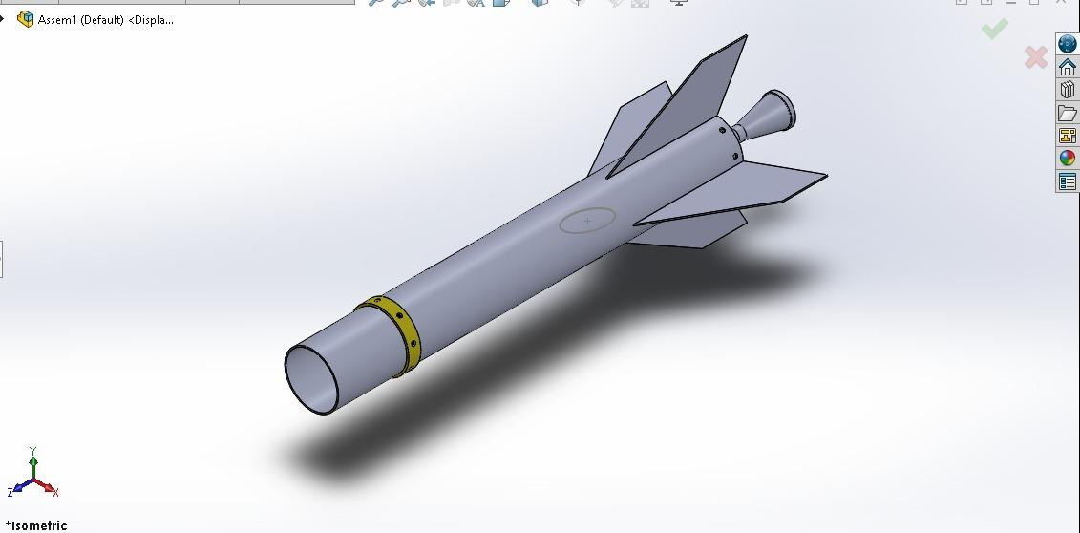
DESIGN OF A FASTER ASSEMBLY MECHANISM
Challenge faced in N3: misalignment of the holes of the airframe, and the other rocket parts.
Proposed solution:
A 3D template with evenly spaced holes that align with the desired location on the cylindrical surface

Slide 12
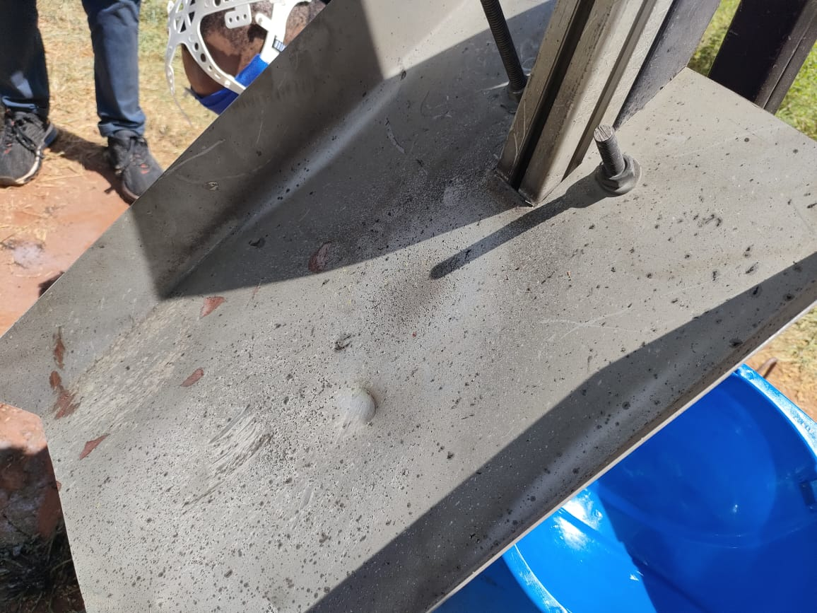
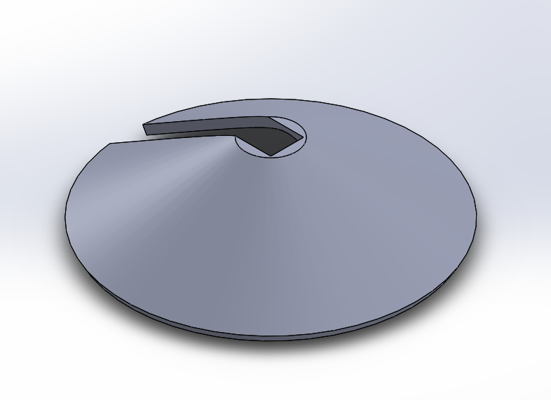
Design of a deflector plate
Purpose-It redirect the intense heat and flames away from the rocket during lift off of the rocket.
N3 design Proposed design
Non uniform distribution of exhaust gases.Certain areas exposed to high heat and forces

Slide 13
THANK
YOU

